Slide 1

Trawell
Presented By Group 4

Slide 2
Summary
With Trawell adventure awaits
With Trawell all you need is desire to explore
Just be ready, we'll take you there

Slide 3




Product Objectives
Provide individual bookings for renting cars, booking train and flight tickets
Create recommended destinations depending on season
Create
adventurous experience and remove hassles
Provide simple user Interface to customers

Slide 4




Product Objectives – Cont'd
Provide simple registration process for consumers
Collect feedback from customers to improve application
Give special all in one - overall packages
Provide Preplanned trips in single itinerary

Slide 5


Product Objectives – Cont'd
Guide options to aid Customer in their Travel
24X7 Customer Support

Slide 6



User needs
A high-quality mobile application with many features
A perfect holiday package
Collect feedback about the website
User-friendly travel application
Notes:
Why user needs ?​ The better you understand your users, the more likely you are to design and build a service that works well for them

Slide 7



User needs
Take reviews of the Tourist places
24 X 7 customer support to the users
Enhanced trust, privacy, and transparency
Offline maps to guide users in absence of internet

Slide 8




User needs
Multi language support
Coupons and discounts to the users
Surveys on customer satisfaction
Adding customer voice with ratings & reviews.

Slide 9
Card sorting
Help design or evaluate the Information Architecture of a site
Participants organize topics into categories that make sense to them
Participants may also help us label these groups

Slide 10
Card sorting Benefits
Help us understand users' expectations.
Help to build the structure of website
Decide what to put on the homepage
Label categories and navigation
Card sorting is simple & Cheap
Card sorting is fast

Slide 11
Open Card sorting
Participants are asked to organize topics from content within the website into groups that make sense to them and then name each group they created in a way that they feel accurately describes the content.
This method is commonly used for new/existing information architectures or organizing products on a site or when starting to create a new IA from scratch.

Slide 12
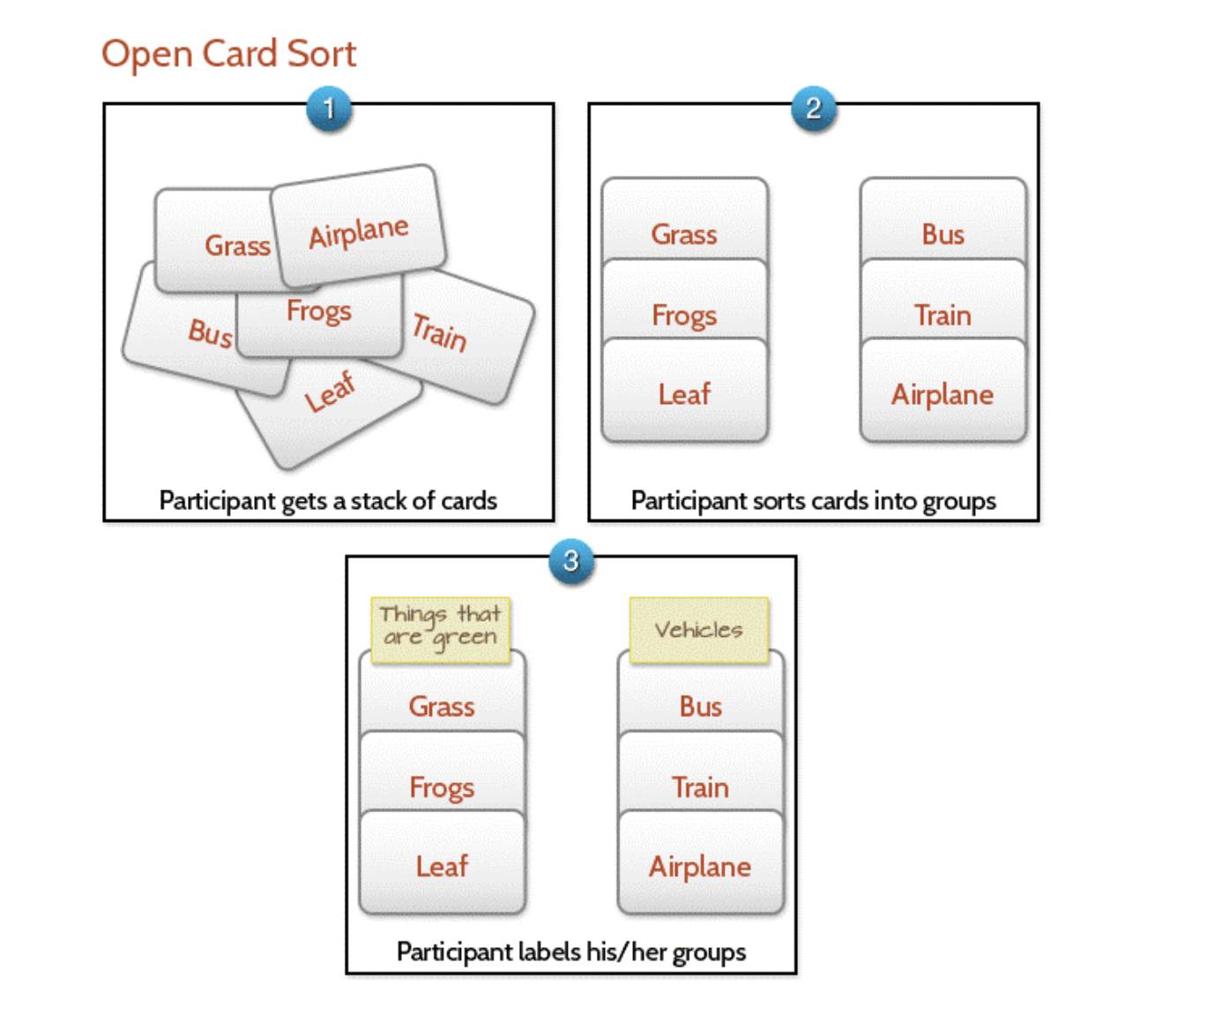
Open Card sorting

Slide 13
Open Card sorting – Explanation
Step 1: Go to https://app.uxtweak.com/dashboard
Step 2 : From Organize content to perfection – Select Card Sorting
Step 3: Select CardSort variant – Open
Step 4: In General Tab – provide study name and make other required changes
Step 5: Under cards tab – define the cards
Step 6: Under card tab (options) – make the required changes
Step 7: If required, we can add Messages, questions & branding details using the respective tabs
Step 8: Before Launching the study , preview it to rectify any errors.
Step 9: Launch the Study
Step 10: Share the study link to the Users and ask them to sort the card based on their understanding.
Step 11: Analyze the results

Slide 14
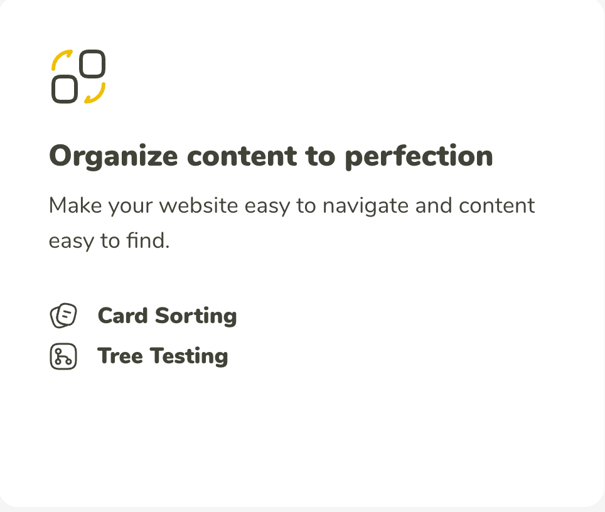
Open Card sorting – Explanation & Screenshots
Step 1: Go to https://app.uxtweak.com/dashboard
Step 2 : From Organize content to perfection – Select
Card Sorting

Slide 15
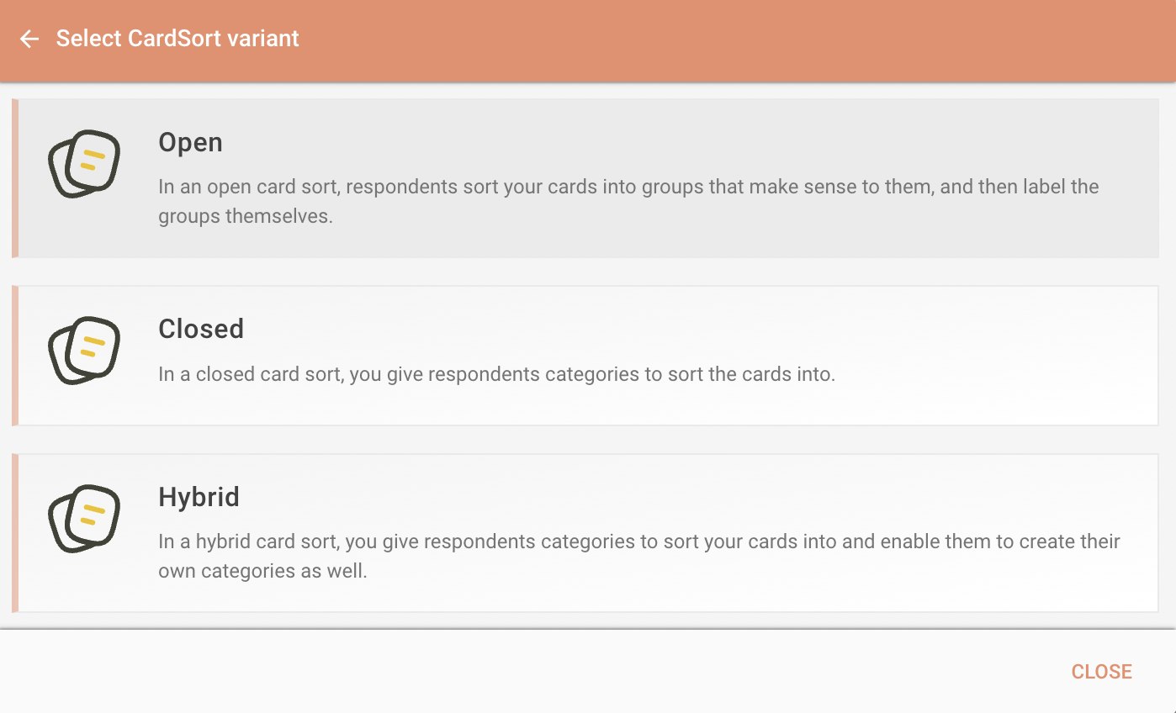
Open Card sorting – Explanation & Screenshots
Step 3: Select CardSort variant – Open

Slide 16
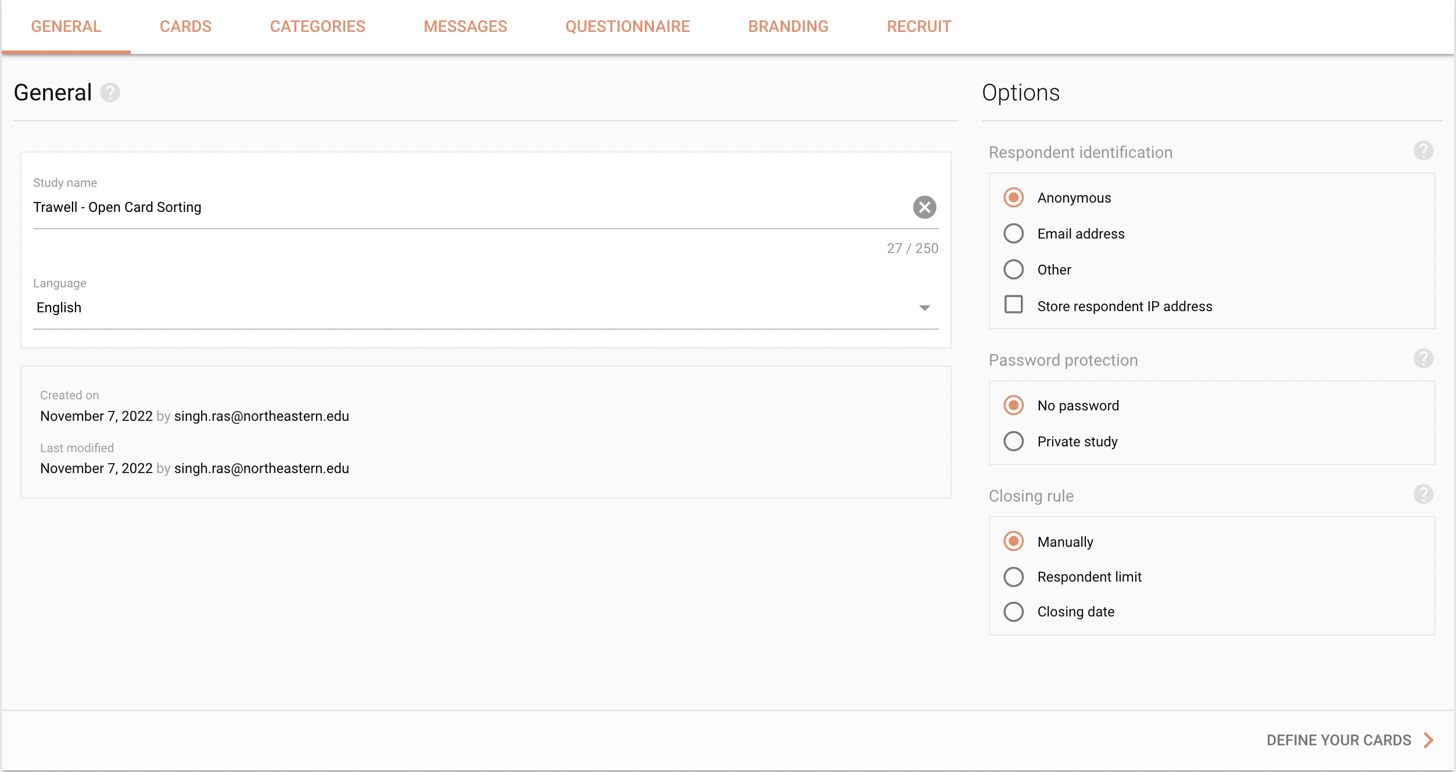
Open Card sorting – Explanation & Screenshots
Step 4: In General Tab – provide study name
and make other required changes

Slide 17
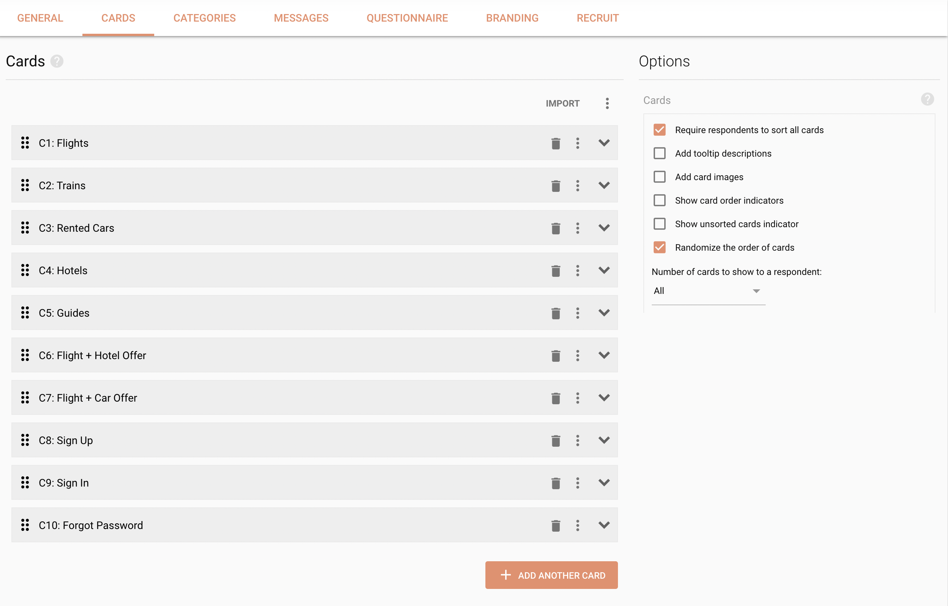
Open Card sorting – Explanation & Screenshots
Step 5: Under cards tab – define the cards
Step 6: Under card tab (options) – make
the required changes

Slide 18
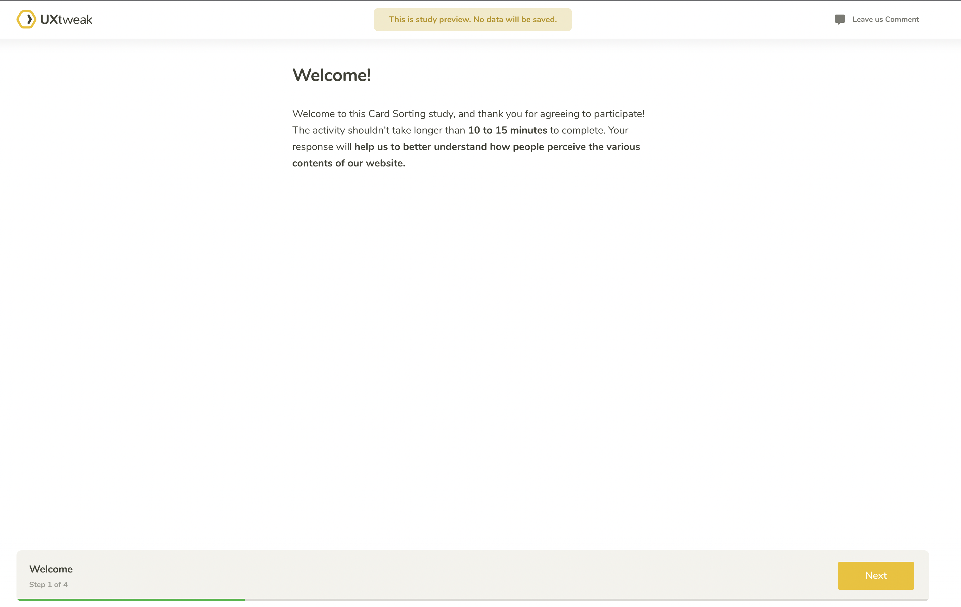
Open Card sorting – Explanation & Screenshots
Step 7: If required, we can add Messages,
questions & branding using respective tabs
Step 8: Before Launching the study , preview
it to rectify any errors.

Slide 19
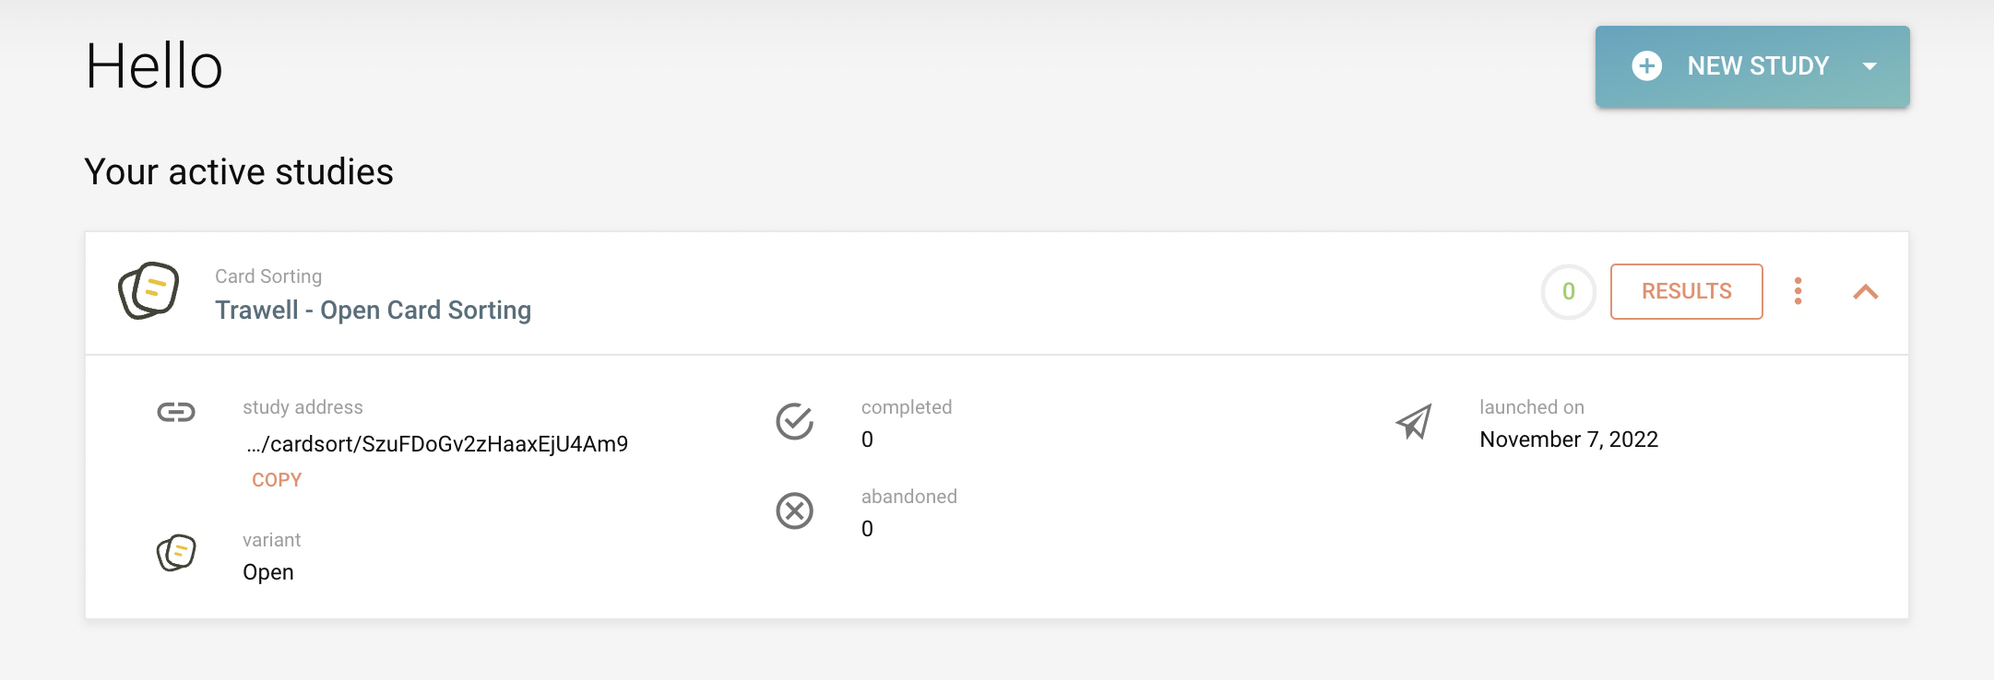
Open Card sorting – Explanation & Screenshots
Step 9: Launch the Study

Slide 20
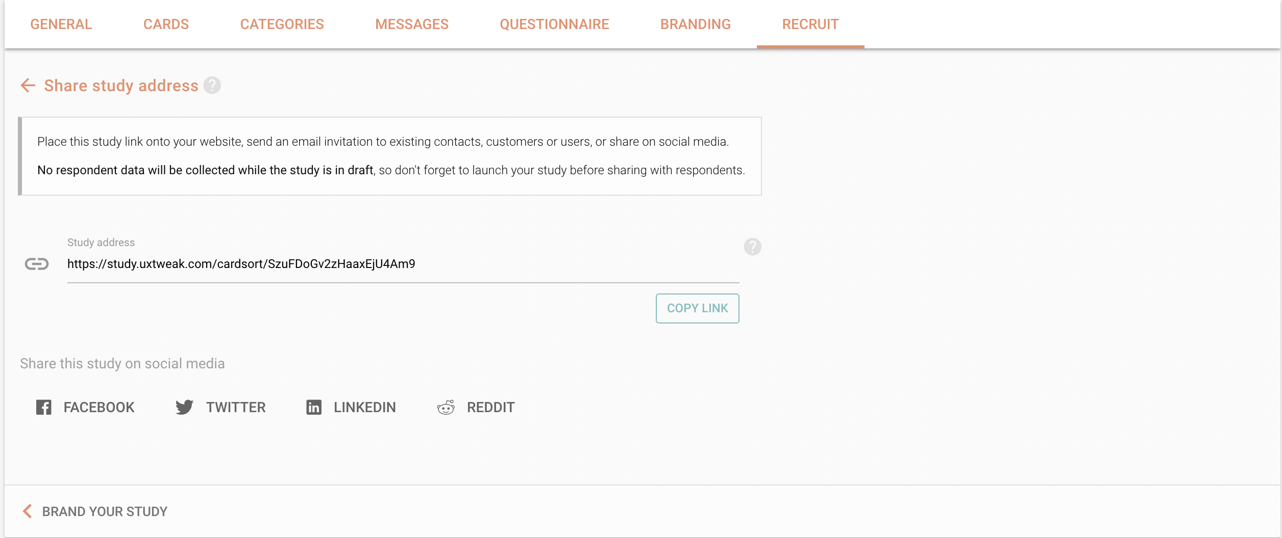
Open Card sorting – Explanation & Screenshots
Step 10: Share the study link to the
Users and ask them to sort the card
based on their understanding.

Slide 21
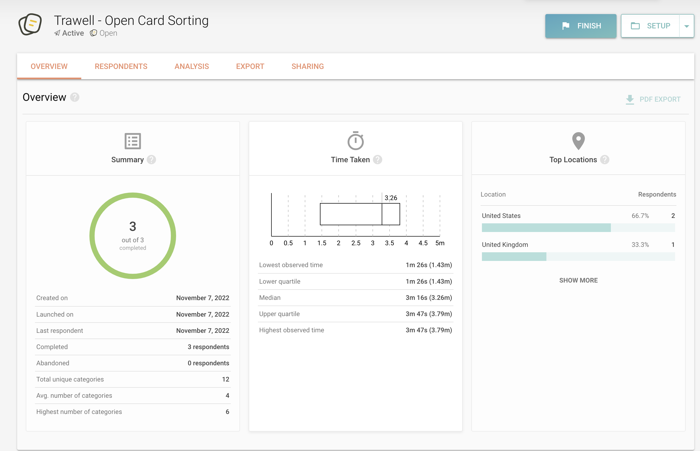
Open Card sorting – Explanation & Screenshots
Step 11 : Analyze the results

Slide 22

Open Card sorting – Result Link
https://app.uxtweak.com/cardsort/results/SzuFDoGv2zHaaxEjU4Am9/K62nC2oPxGNodfaH5tTrw

Slide 23
Closed Card Sorting
Participants are asked to sort topics from content within the website into pre-defined categories. A closed card sort works best when working with a pre-defined set of categories, and we want to learn how users sort content items into each category.
This method is normally used when adding new content to an existing site or gaining a second round of insights after an open card sort.

Slide 24
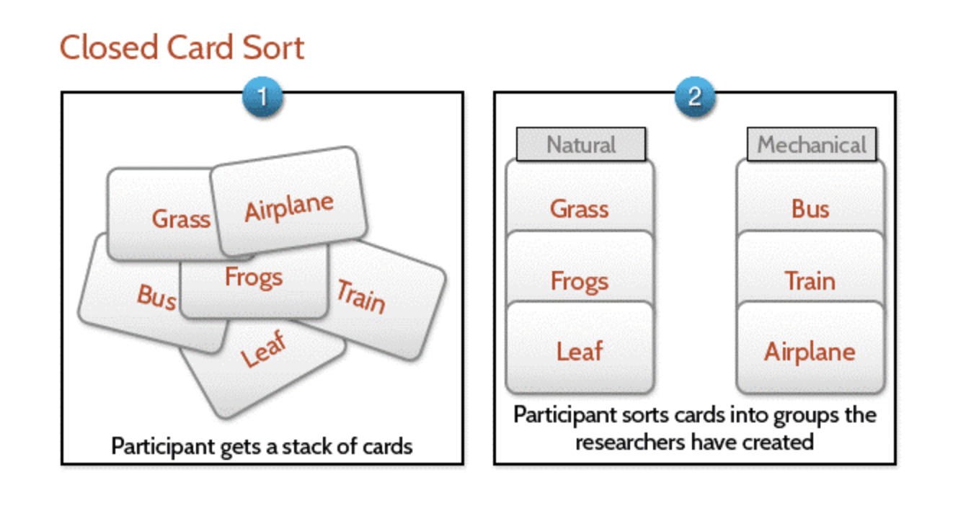
Closed Card Sorting

Slide 25
Closed Card Sorting – Explanation
Step 1: Go to https://app.uxtweak.com/dashboard
Step 2 : From Organize content to perfection – Select Card Sorting
Step 3: Select CardSort variant – Closed
Step 4: In General Tab – provide study name and make other required changes
Step 5: Under cards tab – define the cards
Step 6: Under card tab (options) – make the required changes
Step 7: Under categories tab - add the categories
Step 8: If required, we can add Messages, questions & branding details using the respective tabs
Step 9: Before Launching the study , preview it to rectify any errors.
Step 10: Launch the Study
Step 11: Share the study link to the Users and ask them to sort the card based on their understanding.
Step 12: Analyze the results

Slide 26
Closed Card sorting – Explanation & Screenshots
Step 1: Go to https://app.uxtweak.com/dashboard
Step 2 : From Organize content to perfection – Select
Card Sorting

Slide 27
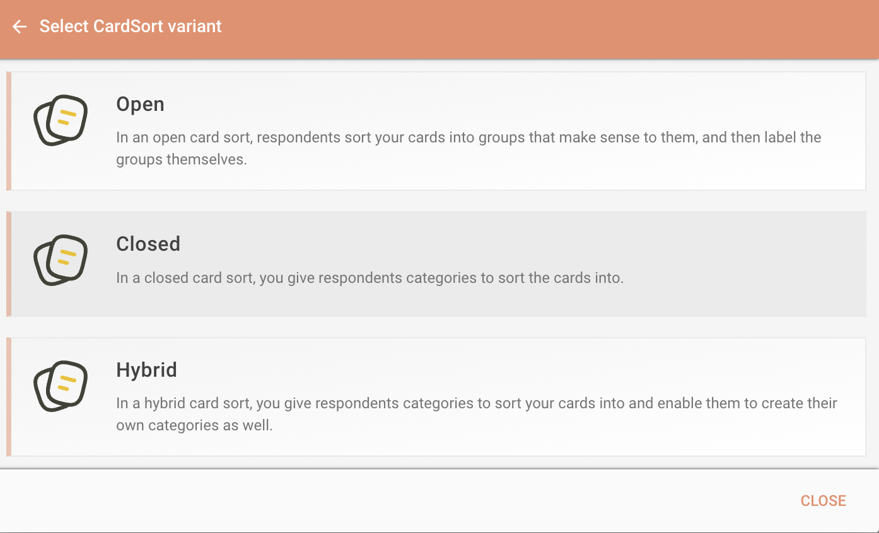
Closed Card sorting – Explanation & Screenshots
Step 3: Select CardSort variant – Closed

Slide 28
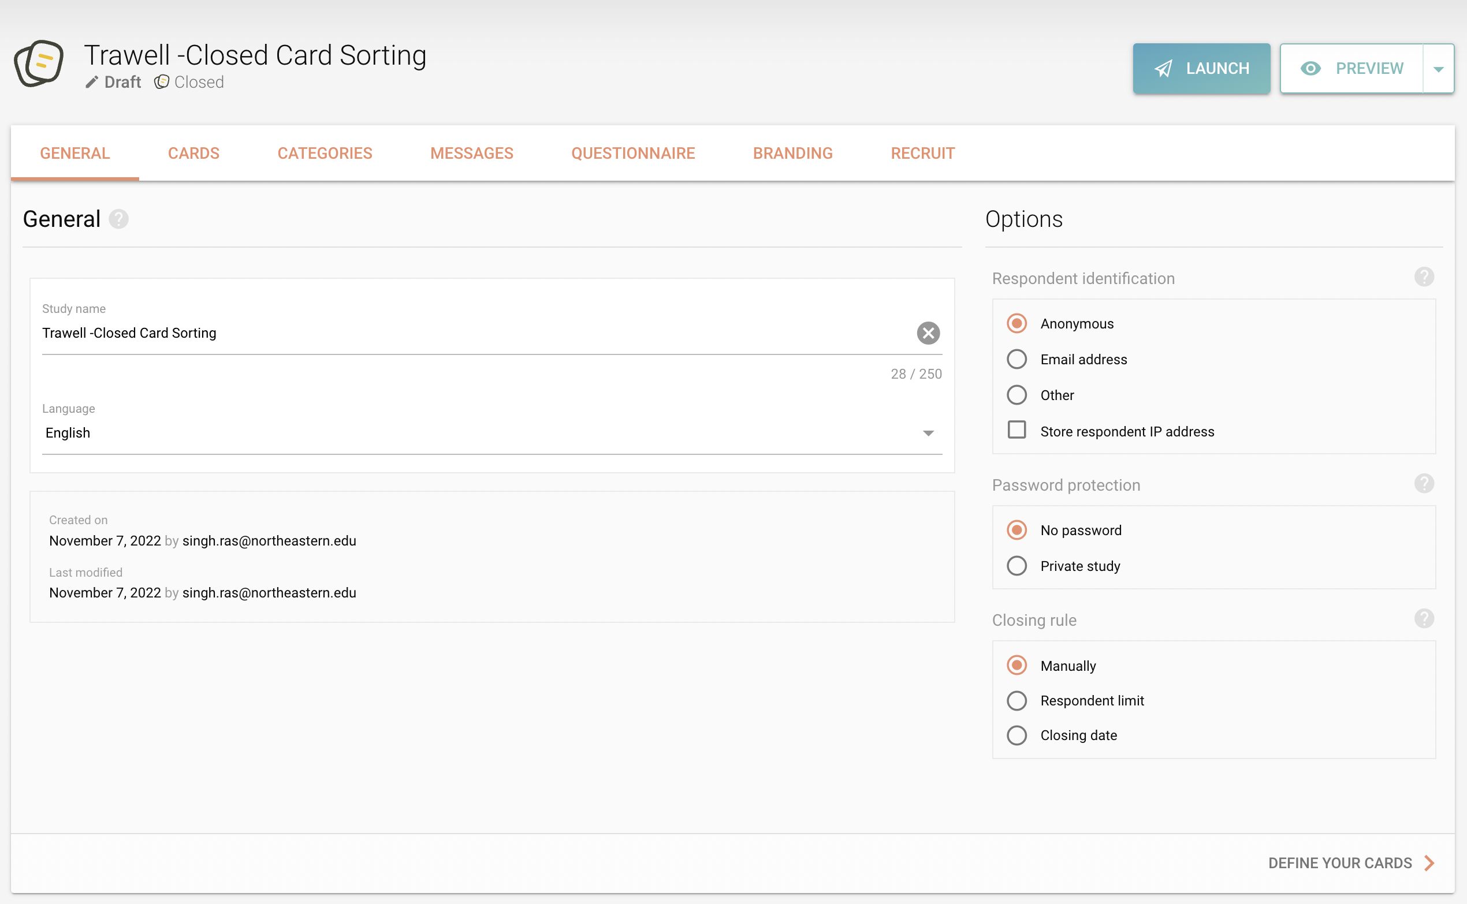
CLOSED Card sorting – Explanation & Screenshots
Step 4: In General Tab – provide study name
and make other required changes

Slide 29
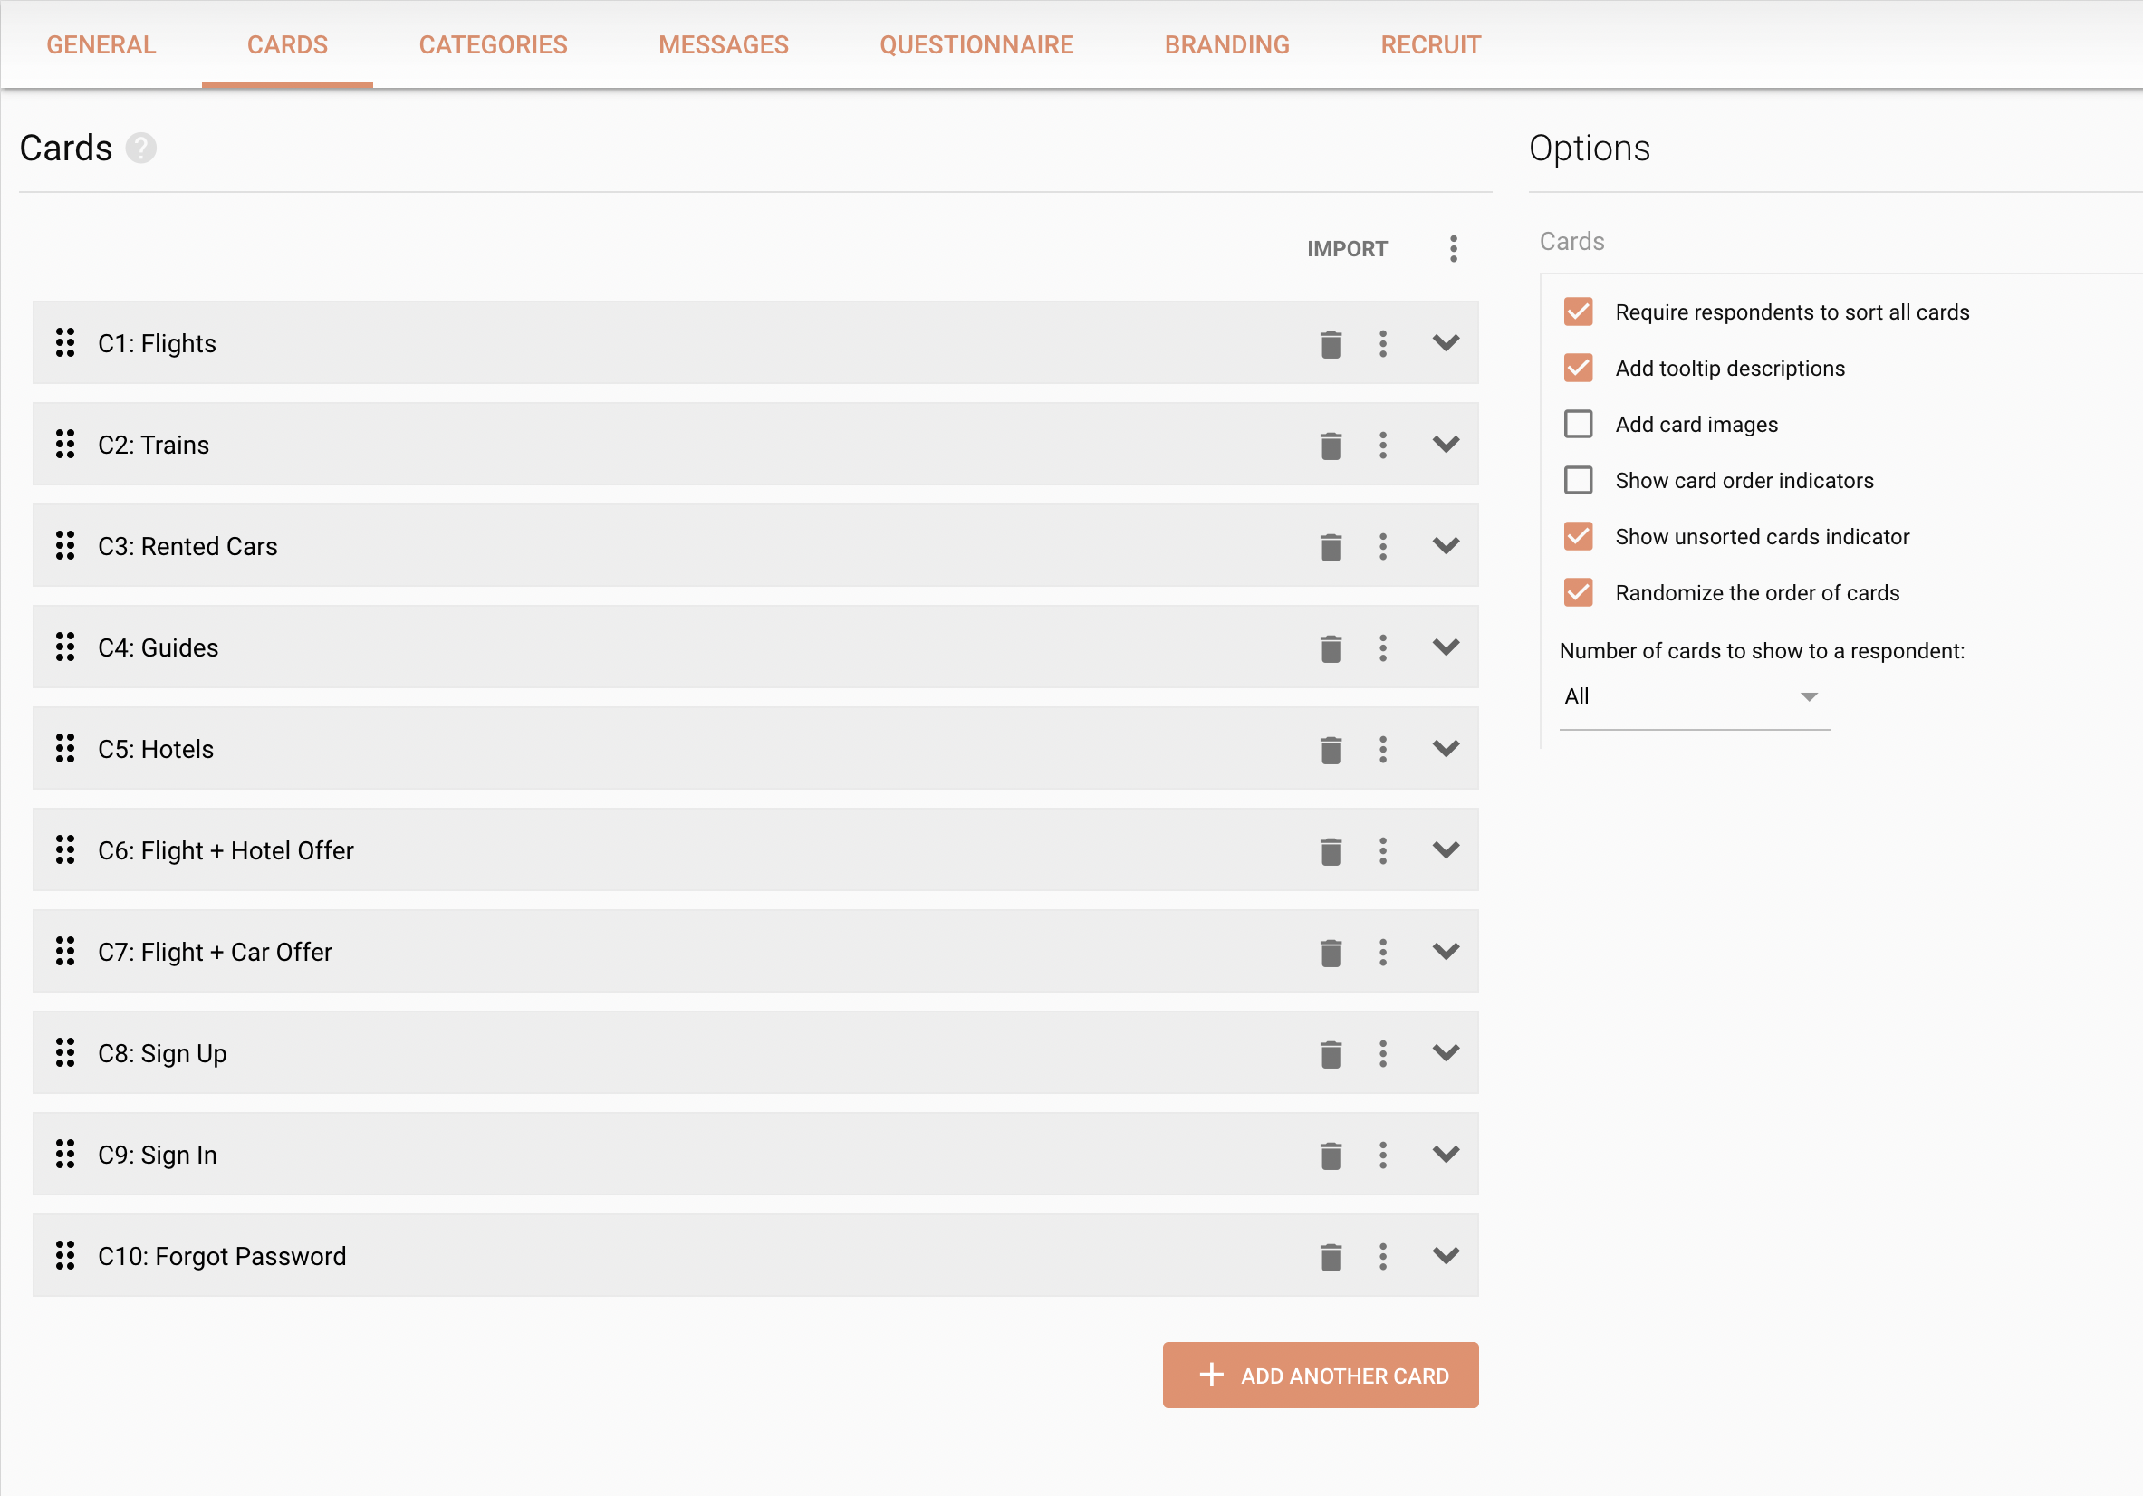
Closed Card sorting – Explanation & Screenshots
Step 5: Under cards tab – define the cards
Step 6: Under card tab (options) – make the
required changes

Slide 30
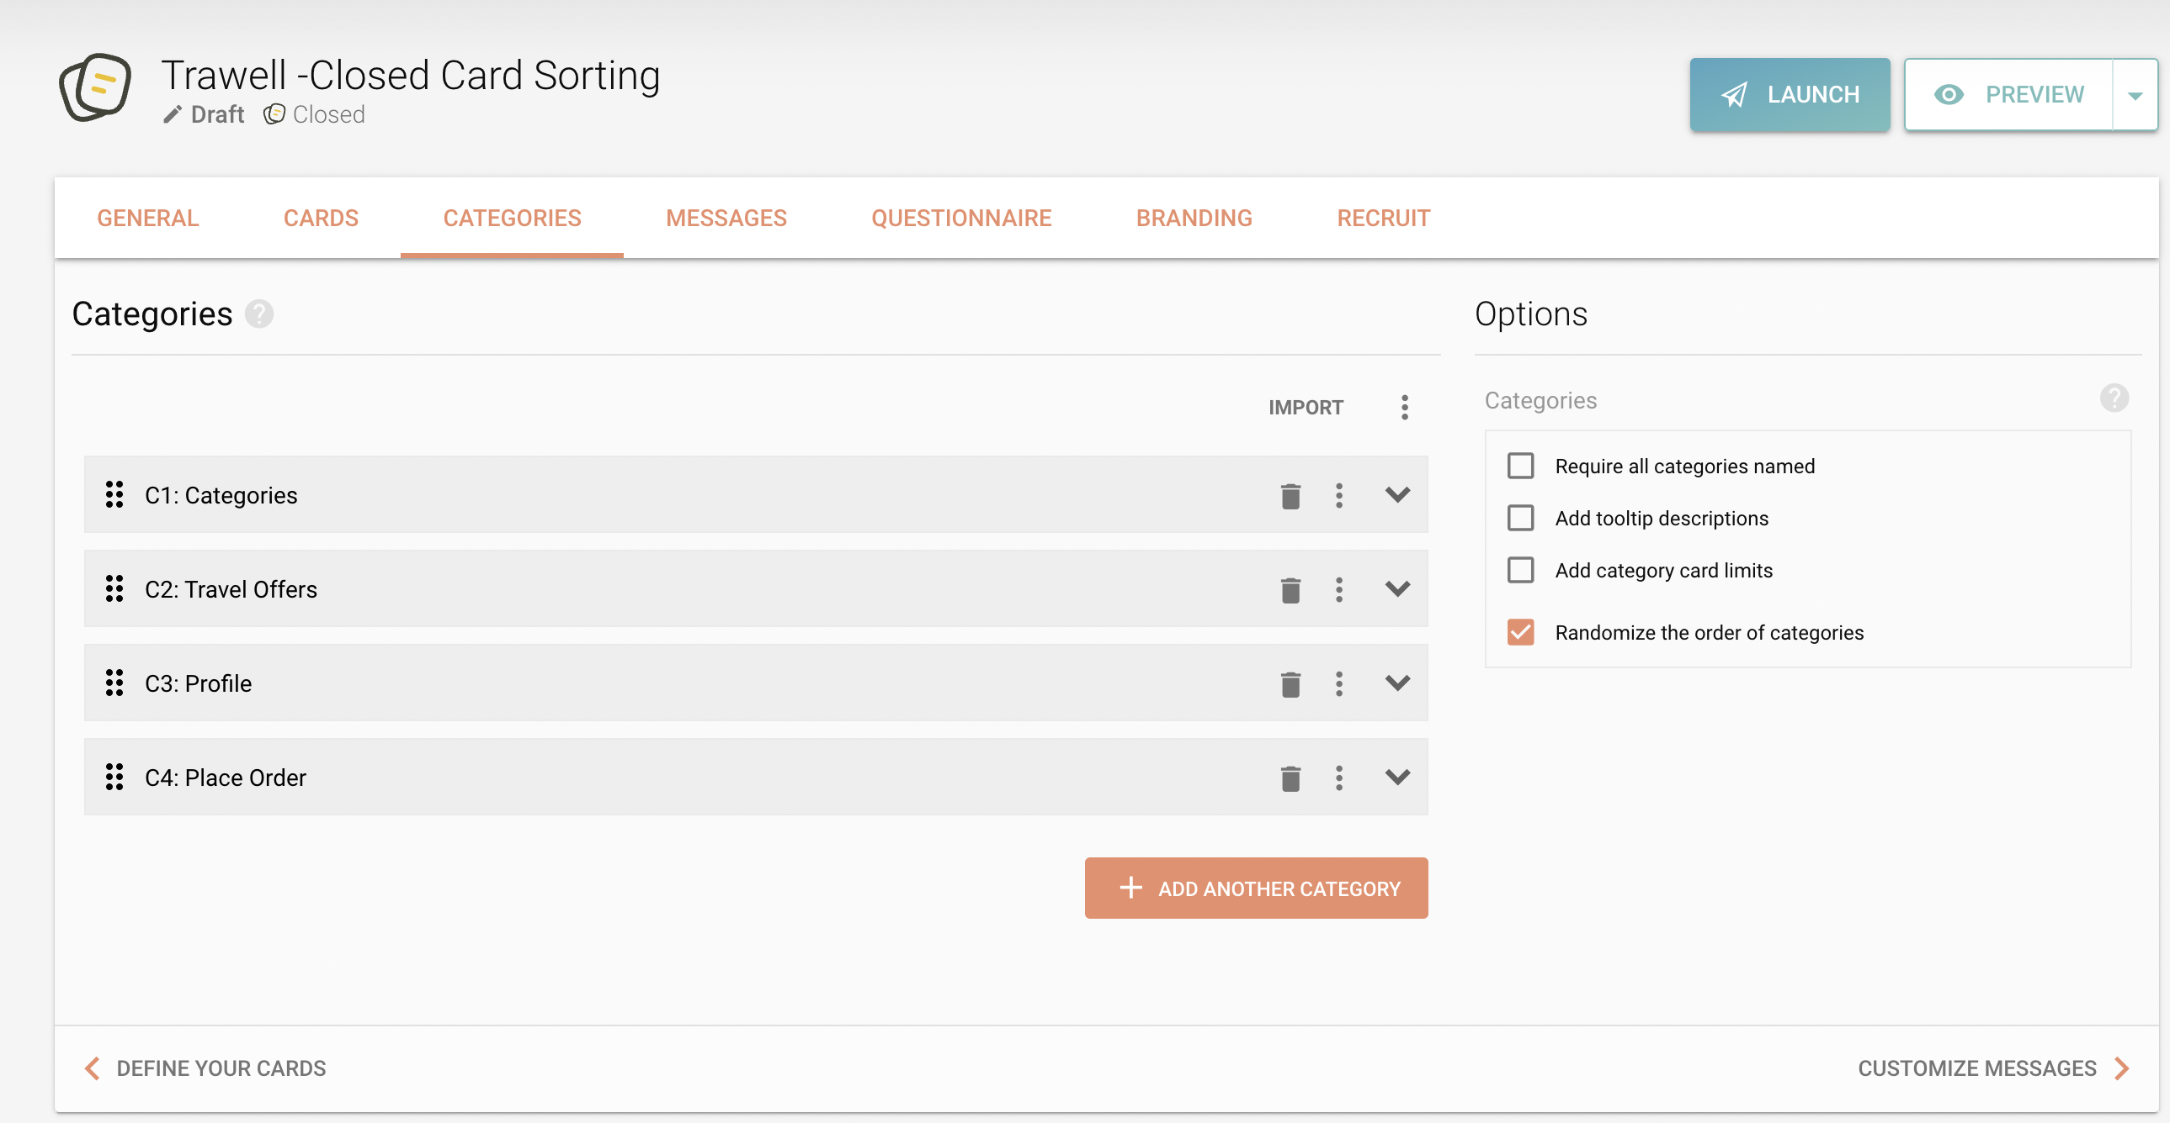
Closed Card sorting – Explanation & Screenshots
Step 7: Under categories tab - add the
categories

Slide 31
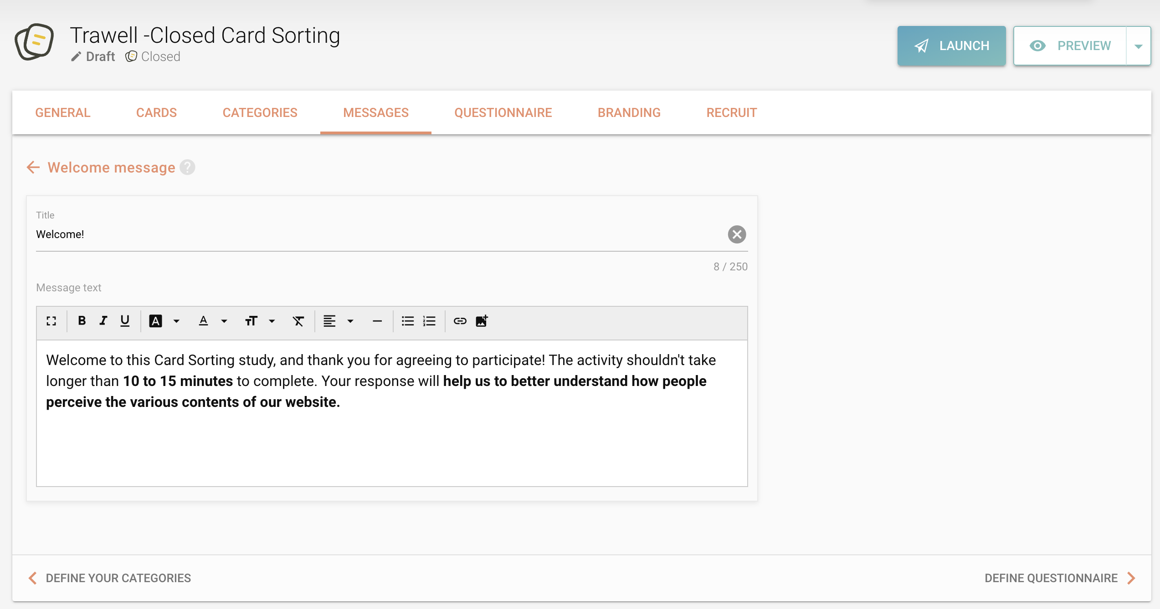
Closed Card sorting – Explanation & Screenshots
Step 8: If required, we can add Messages,
questions & branding using respective tabs

Slide 32
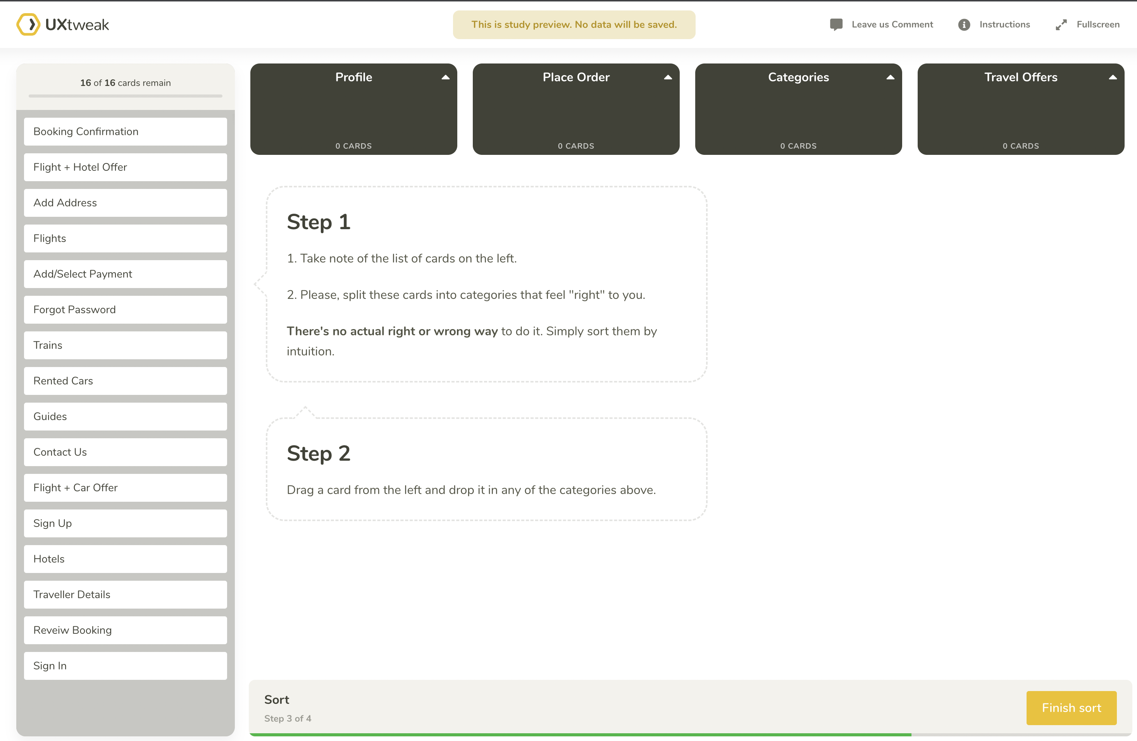
Closed Card sorting – Explanation & Screenshots
Step 9: Before Launching the study , preview
it to rectify any errors.

Slide 33
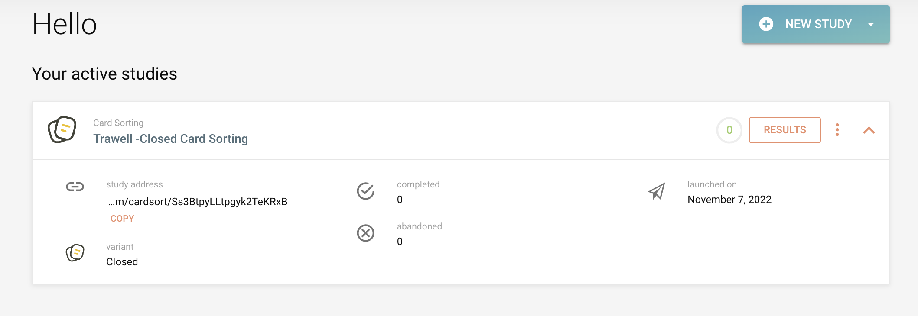
Closed Card sorting – Explanation & Screenshots
Step 9: Launch the Study

Slide 34
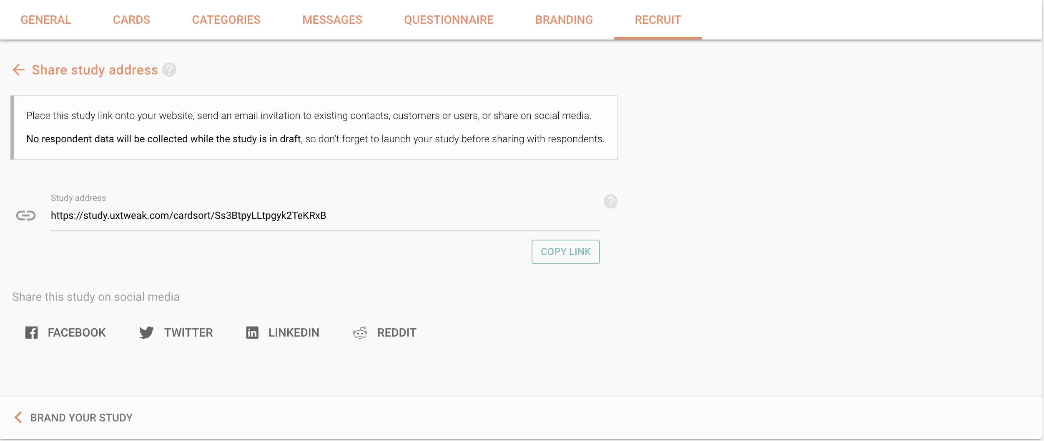
Closed Card sorting – Explanation & Screenshots
Step 10: Share the study link to the Users
and ask them to sort the card based
on their understanding.

Slide 35
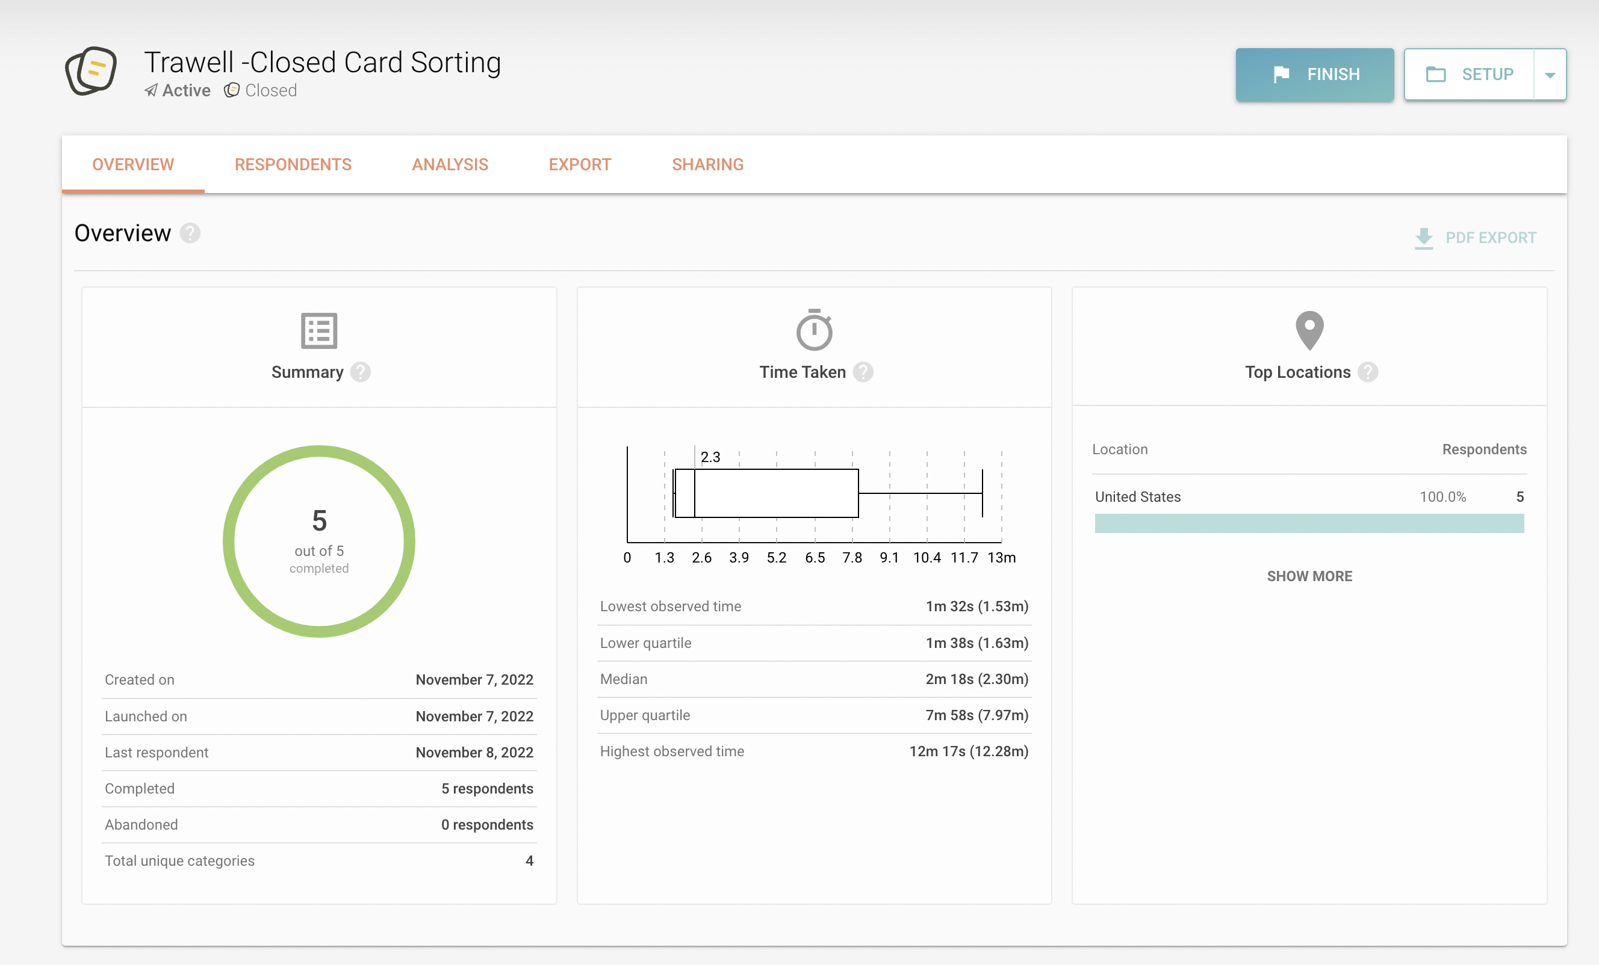
Closed Card sorting – Explanation & Screenshots
Step 11 : Analyze the results

Slide 36
Closed Card sorting – Result Link
https://app.uxtweak.com/cardsort/results/Ss3BtpyLLtpgyk2TeKRxB/UWcsL6UOylfazyPq0Lwi7

Slide 37
Steps Taken for Information Architecture Design
STEP 1
We conducted customer research
STEP 2
Based on the outcome of the research , we updated and reviewed the content
STEP 3
Next , we applied the card sorting for content classification
STEP 4
We built a website hierarchy for user-friendly navigation
STEP 5
Lastly, we created a UI prototype for future development

Slide 38
Information Architecture Design Styles
We have used Bottoms up approach for designing our architecture.
We started with the creation of user personas and how those users will be going through the site
From there, we figured out how to tie it all together.

Slide 39
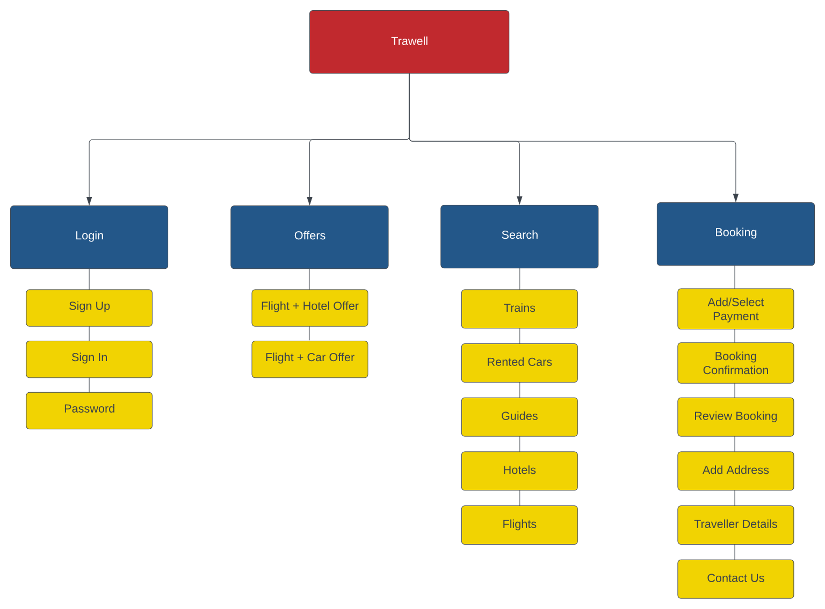
IA – Open Card sorting

Slide 40
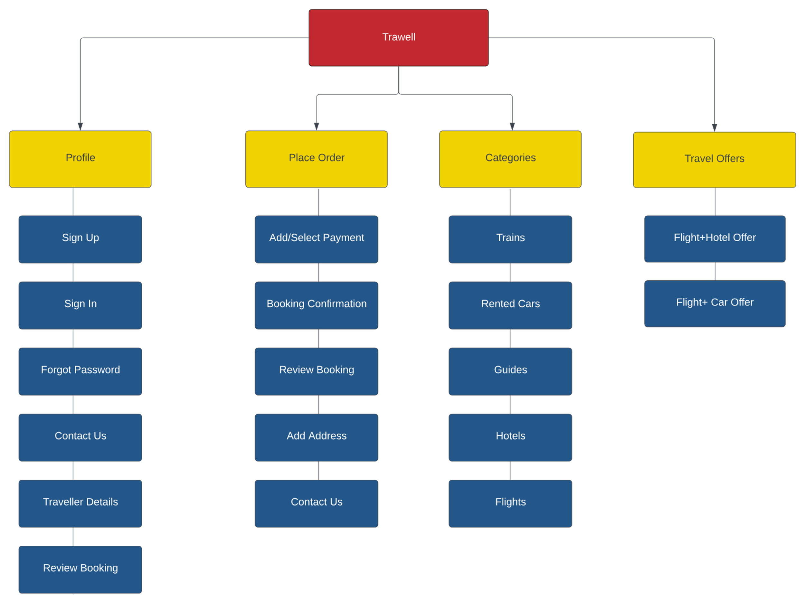
IA – Closed Card sorting

Slide 41
Appendix
Open Card Sorting Result | https://app.uxtweak.com/cardsort/results/SzuFDoGv2zHaaxEjU4Am9/K62nC2oPxGNodfaH5tTrw
Closed Card Sorting Result | https://app.uxtweak.com/cardsort/results/Ss3BtpyLLtpgyk2TeKRxB/UWcsL6UOylfazyPq0Lwi7

Slide 42
References
https://www.usability.gov/how-to-and-tools/methods/card-sorting.html#:~:text=Card%20sorting%20is%20a%20method,help%20you%20label%20these%20groups.
https://www.experienceux.co.uk/faqs/what-is-card-sorting/
https://uxdesign.cc/card-sorting-what-how-the-perks-29f6cb020270
https://www.optimalworkshop.com/learn/101s/card-sorting/
https://xd.adobe.com/ideas/process/information-architecture/card-sorting-best-practices/
https://www.interaction-design.org/literature/article/the-pros-and-cons-of-card-sorting-in-ux-research
https://usabilitygeek.com/card-sorting-quick-guide-for-beginners/

